Slide 1

passive cooling system for home
KNOWLEDGE INSTITUTE OF TECHNOLOGY

Slide 2
PASSIVE COOLING SYSTEM FOR HOME
KNOWLEDGE INSTITUTE OF TECHNOLOGY
Cool Living Without AC
A low-cost passive cooling model using Shading + Cross Ventilation to reduce indoor temperature naturally, improve airflow, and reduce electricity consumption..

Slide 3
Double Content Slide
KNOWLEDGE INSTITUTE OF TECHNOLOGY
Technical Architecture
The system uses shading and cross ventilation for natural cooling. An ESP32 collects temperature data from three sensors placed at the inlet, indoor room, and outlet. An RTC module provides timestamps, and all readings are stored in an SD card for analysis.
User Value & Impact
The system reduces indoor temperature without using electrical cooling. Sensor-based monitoring validates performance scientifically. It is a low-cost and eco-friendly solution for sustainable housing.

Slide 4
Bulleted List Slide
KNOWLEDGE INSTITUTE OF TECHNOLOGY
Natural Cooling System – No AC required
Shading Mechanism – Reduces direct solar heat gain
Cross Ventilation – Continuous airflow circulation
ESP32 Monitoring – Smart temperature tracking
RTC Integration – Time-based data recording
Three-Point Temperature Analysis – Inlet, Indoor & Outlet
Low-Cost & Sustainable Design

Slide 5
Comparison Slide
KNOWLEDGE INSTITUTE OF TECHNOLOGY
Compare Section
Contrast Section
Like conventional cooling systems, our model focuses on reducing indoor temperature and improving thermal comfort during hot weather.
Unlike air conditioners that consume high electricity and increase cost, our passive cooling system works naturally without power consumption.
Additionally, smart monitoring using ESP32 and sensors provides real-time performance evaluation, which traditional passive designs do not offer.

Slide 6
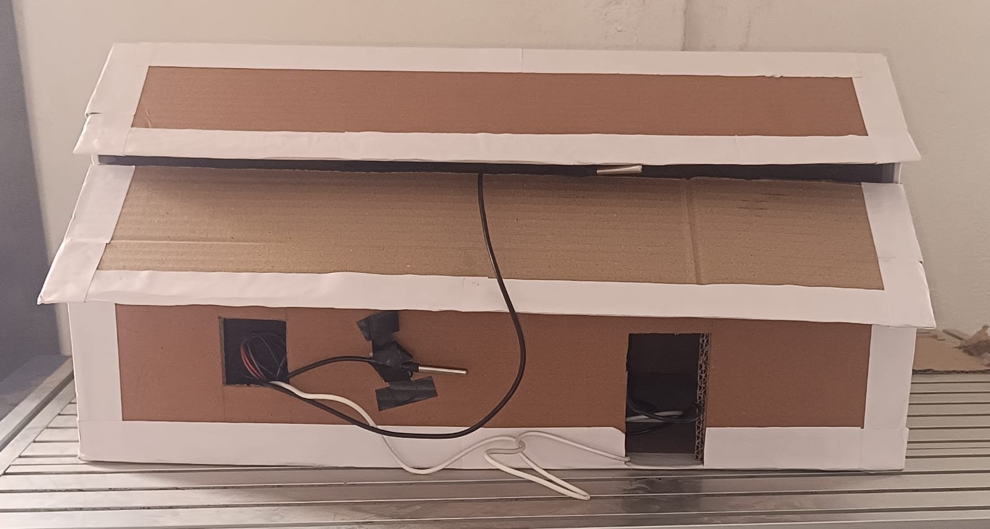
Prototype
KNOWLEDGE INSTITUTE OF TECHNOLOGY
Shaded roof to reduce solar heat gain
Opposite openings for cross ventilation
ESP32 for temperature data collection
RTC module for timestamp recording
Three sensors – Inlet, Indoor, Outlet
SD card module for data storage
Compact and practical demo model

Slide 7
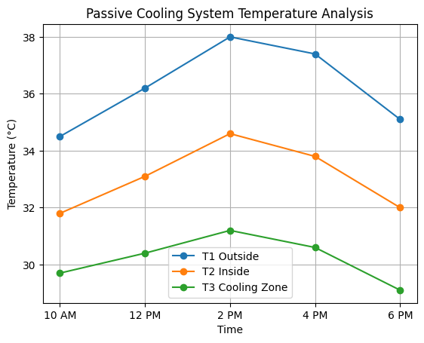
Detection Breakdown
KNOWLEDGE INSTITUTE OF TECHNOLOGY
Temperature data was recorded from inlet, indoor, and outlet sensors during testing. Readings were timestamped using the RTC module and stored in the SD card for analysis. Cooling performance may vary based on environmental conditions and airflow.

Slide 8
CONCLUSION
KNOWLEDGE INSTITUTE OF TECHNOLOGY
Sustainable Cooling with Smart Validation
The Passive Cooling System demonstrates that indoor temperature can be effectively reduced using shading and cross ventilation techniques. With integrated ESP32-based monitoring, the system validates temperature reduction scientifically.
It proves to be a low-cost, eco-friendly, and energy-efficient alternative to conventional cooling systems.

